Slide 1
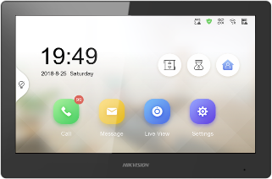
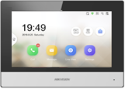
Video Intercom Easy UI 2.0
Technical Training

Slide 2
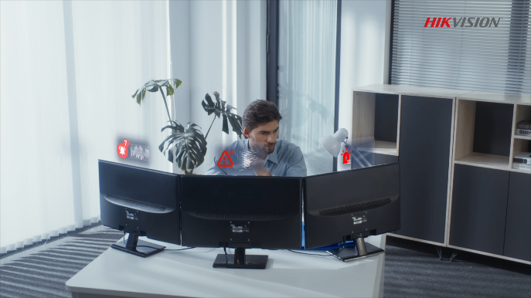
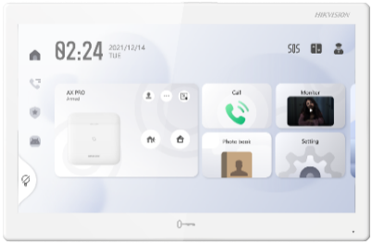
IP Video Intercom
Pain Points Of IP Product Configuration For Installers
Professional IP knowledge required
Configuration in both software & web
1
Supports adding multiple door stations with automatic IP assignment
2
one-way registration
3
Main indoor station can locally configure some important parameters
Each device needs to be configured separately
Notes:
Here I would like to focus on our new UI. This page shows some of the market pain points (especially for installers), where installers are faced with the need for expertise when installing devices, the need for a computer web interface or various software, and also the need for separate operations when configuring devices locally, making configuration very complicated.
This new UI update will largely solve these worries. The new UI 2.0 contains two key features, a new Quick Setup Wizard 2.0 and On-device configuration without PC. We will also be following up with the release of the One-touch click for resetting feature.
安装商在安装设备时，会面临需要专业知识，需要电脑web端或各种软件的问题，同时在设备本地配置时也需要分别操作，使配置十分麻烦。
新的UI 2.0将解决这些问题。目前已升级的UI包含两大重点功能，一是新的快速开机向导，二是去PC化设备本地配置。后续我们还会有一键修复功能的发布。

Slide 3
Easy Wizard
On-device configuration
FAQ
CONTENTS

Slide 4
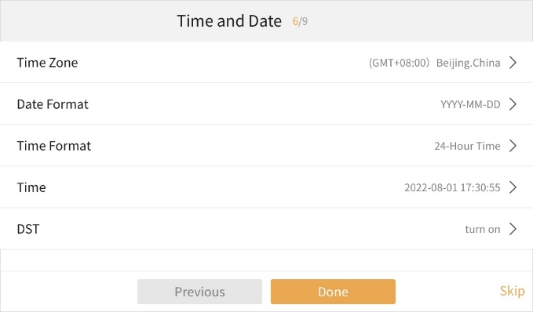
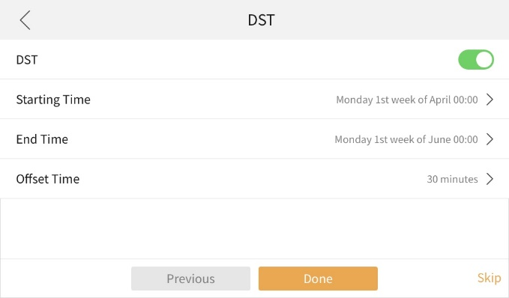
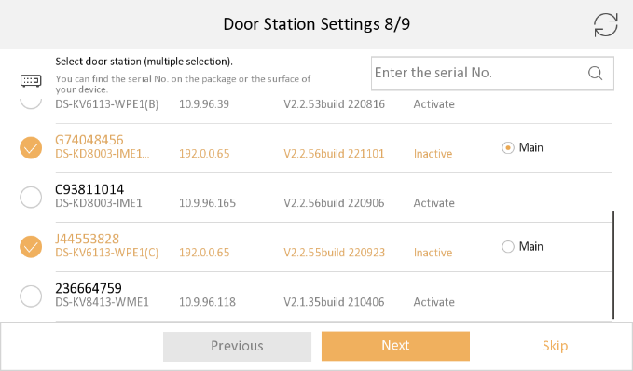
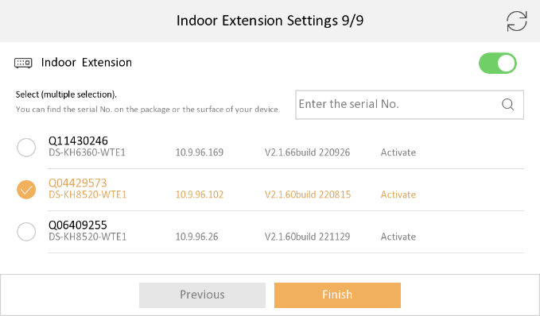
IP Video Intercom
Easy UI 2.0 – Quick Setup With Easy Wizard 2.0
1. Activating the device
2. Network settings
3. Time Setting (Summer Time option)
4. Call-to-phone settings
5. Associated door station
6. Associated indoor extension
The time configured for the indoor station can be automatically synchronised to the door station
One-touch configuration of door stations & indoor extensions on the new wizard 2.0
PC-Free
Simple, convenient and efficient
Notes:
The new boot-up wizard eliminates the need for PC configuration and allows you to complete key configurations via a few steps on the touch screen. Compared to the previous version, the wizard 2.0 allows you to add multiple door stations, achieve one-way registration, automatic IP assignment and background door station configuration. We have also added the option of daylight saving time to the time settings, making it more user-friendly. On the next page we will focus on the background door station configuration
新的开机向导消除了对PC配置的需要，使你能通过触摸屏上的几个步骤完成关键配置。与以前的版本相比，2.0版本的向导允许添加多个门口机，实现单向注册、自动IP分配和后台门口机配置。同时在时间设置中我们新增了夏令时的选项，更加的人性化。下一页我们将重点来看后台门口机的配置

Slide 5
Easy UI 2.0
Easy Wizard-Available models & Version
Type | Platform | Device Model | Firmware Version
IP Series | R0 | DS-KH6320-(W)TE1 | VIS_INDOOR_R0_EN_STD_V2.2.2_build221129
 |  | DS-KH8350-(W)TE1
 |  | DS-KH8520-WTE1
 | B1 pro | DS-KH6350-(W)TE1 | VIS_INDOOR_B1pro_EN_STD_V2.2.2_build221128
Two-wire IP | R0 | DS-KH6320Y-WTE2 | VIS_INDOOR_R0_EN_STD_V2.2.2_build221129
 |  | DS-KH6320-WTE2(B)
Indoor station
This version indoor station firmware is compatible with both protocol 1.0 and 2.0 door station firmware
DS-KH8350/ 8520 series
Device of Door station | Firmware | Protocol Type
First Generation | V1.5.0 & V1.5.1 | Protocol 1.0
KD8003 | V2.0.X | Protocol 1.0
 | V2.2.3 and above | Protocol 2.0
KV(B) Series | V2.1.X | Protocol 1.0
 | V2.2.3 and above | Protocol 2.0
KV(C) Series | All | Protocol 2.0
KB8113 | V2.2.1 | Protocol 1.0
 | V2.2.10 and above | Protocol 2.0
KD9203/KD3003/KD8103/KD8023 | All | Protocol 2.0
DS-KH6320 / 6350 series

Slide 6
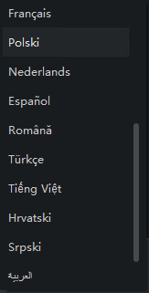
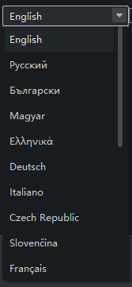
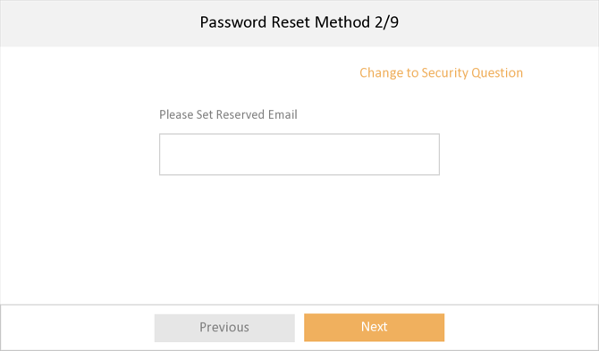
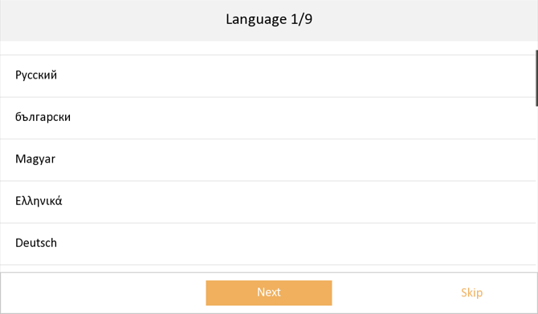
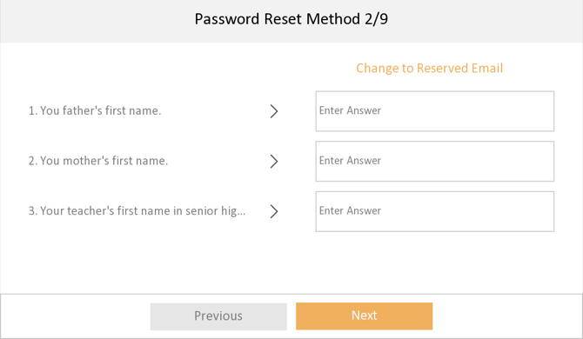
Easy UI 2.0
Easy Wizard-Interface Show
Step1: language selection
(support 21 languages)
Step2: Password reset (reserved email or security question)
Note: Please ensure that you entered correct email address/security question & answer for password retrieval

Slide 7
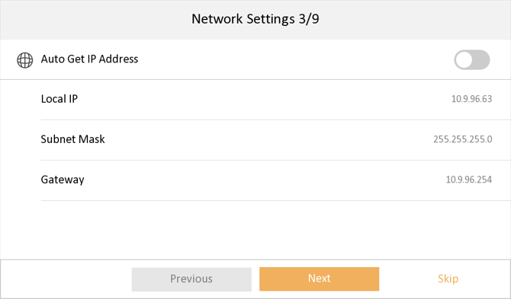
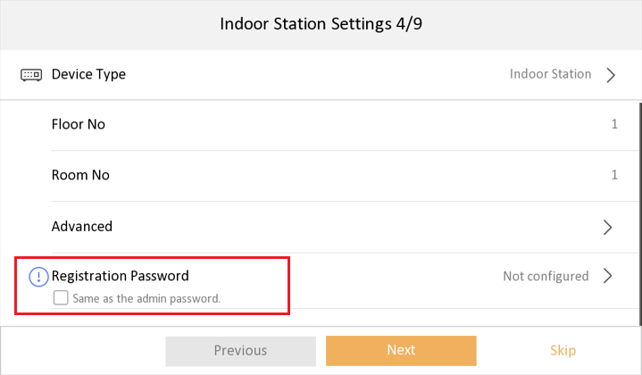
Easy UI 2.0
Easy Wizard-Interface Show
Step3: Network parameter settings (DHCP or set manually)
Note: indoor station will set all linked devices in future steps to same network segment.
Step4: Quick setting for registration password
After checked, the registration password of indoor station will be consistent with its activation password, no need to input manually.
Note: Registration password is used to register between devices, if different, it will cause calling failed. All devices in same intercom system must use same registration password.

Slide 8
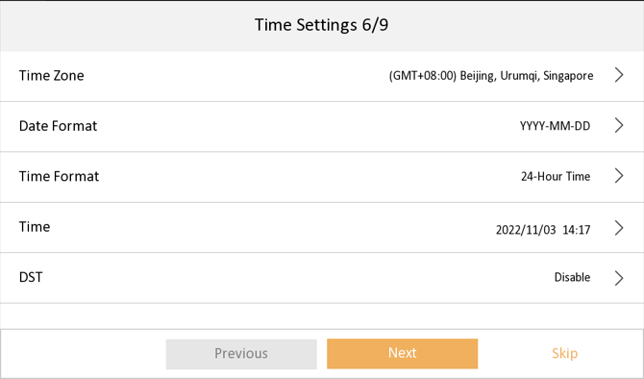
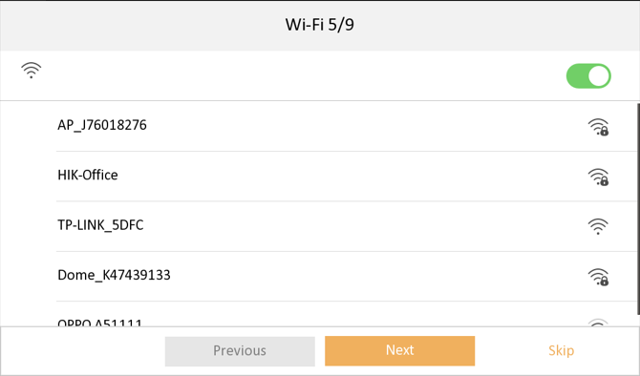
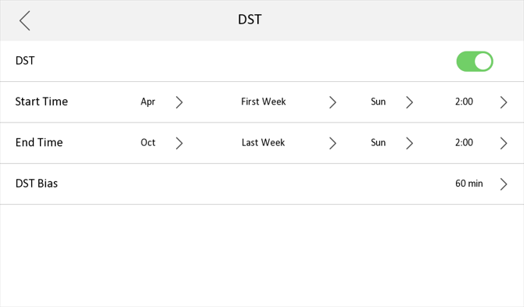
Easy UI 2.0
Easy Wizard-Interface Show
Step6: Time settings
Note: The time will be synchronized to other connected devices after the wizard finish
Step5: Wi-Fi settings
(support 2.4GHz Wi-Fi)
Notes:
Please use slideshow full screen

Slide 9
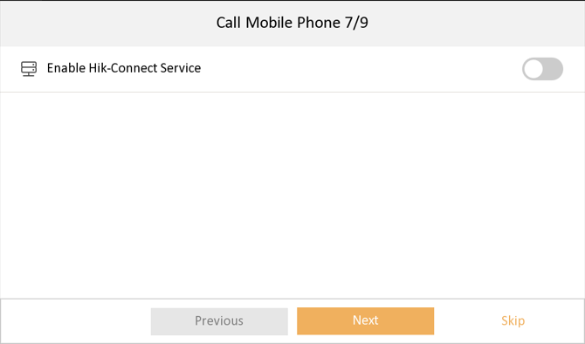
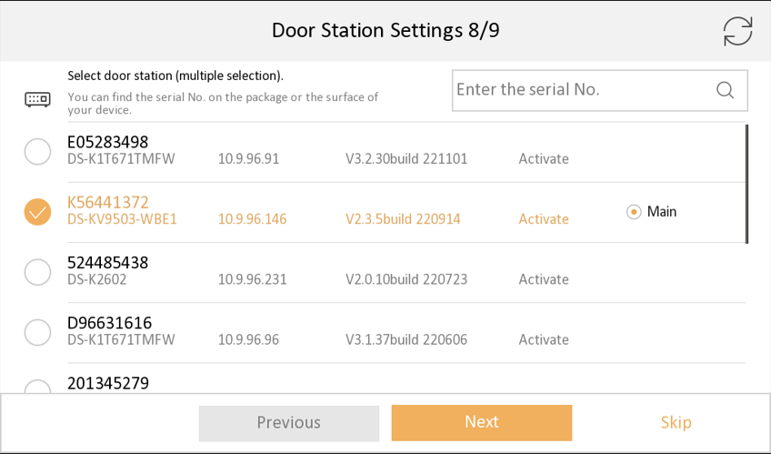
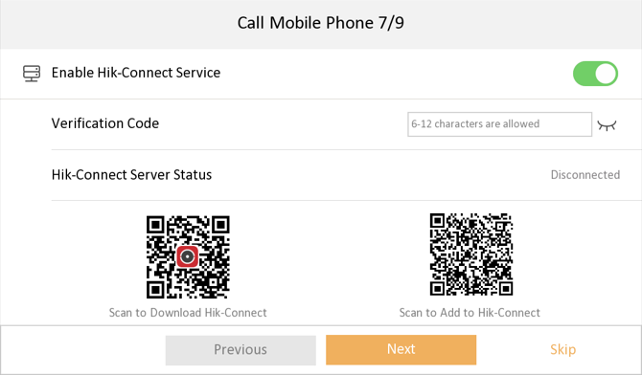
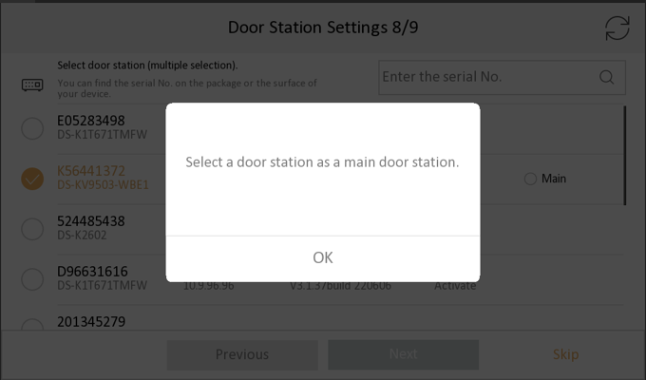
Easy UI 2.0
Easy Wizard-Interface Show
Step8: Door station settings
Note:
1. the first selected will be the main door station by default, the second will be sub1, 3rd will be sub2, etc. You can also cancel and select the main door station manually.
2. Maximum select 17 door stations at one time (1 main and 16 sub door stations)
3. If the selected devices are not activated, indoor station will activate them with same activation and registration password, then set the IP address for them in same network segment automatically.
4. If the door station is already activated with different password, it will prompt you to input door station password
5. If the main and sub door station are activated with different activation password, the registration will be failed (sub door station can’t call indoor station).
Step7: Hik-Connect settings, set the verification code and scan QR code to add device.
Note:
1. Please make sure the device time is correct, or the call will not be forwarded to Hik-Connect.
2. If the Wi-Fi is connected, please modify router DNS to 8.8.8.8 to solve connection failure issue.

Slide 10
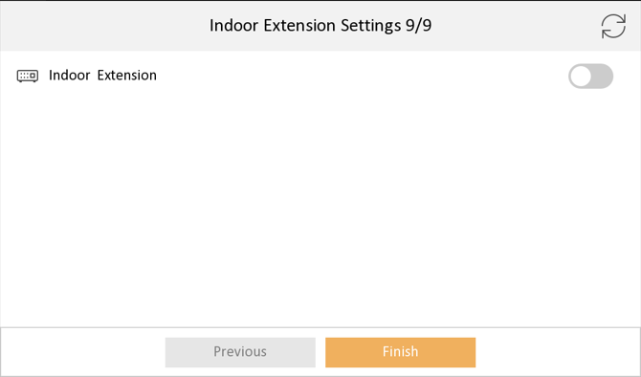
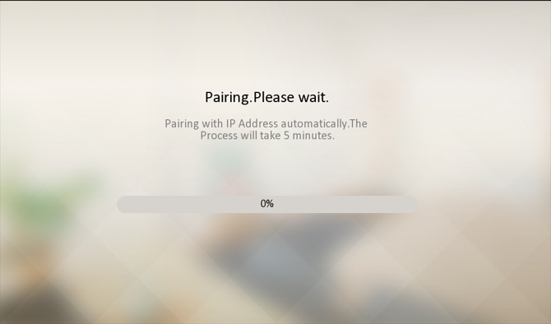
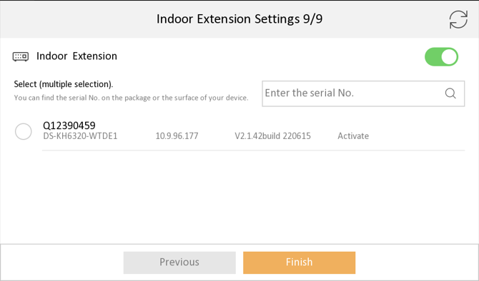
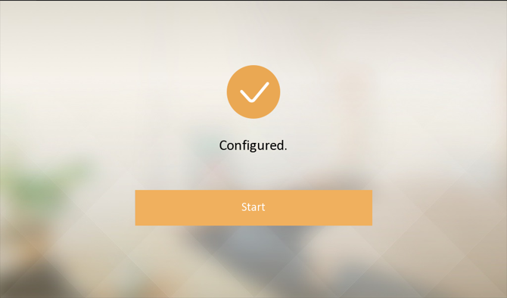
Easy UI 2.0
Easy Wizard-Interface Show
Step9: Indoor station extension connection
Note:
1.The selected indoor station will be and numbered as indoor extension 1,2,3…
2. Maximum select 5 indoor extensions at one time
3. If the selected devices are not activated, indoor station will activate them with same activation and registration password, then set the IP address for them in same network segment automatically.
4. If the selected devices are activated with different password, the registration will be failed (door station can’t call indoor extension).
The pairing time duration depends on the device quantity you selected in previous steps, it will take about up to 5 mins, please wait patiently until the process show “Configured” , if not, please refer to last part FAQ.
Note:
1. Recommend to keep all other out door and indoor station in inactive status before the wizard, or use same activation and registration password.
2.If other linked door station and indoor extension are not activated, indoor station will activated them with same activation and registration password.
3. Indoor station will set network parameters for other devices
4. The time, language will also be synchronized to other devices

Slide 11
Easy Wizard
On-device configuration
FAQ
CONTENTS

Slide 12
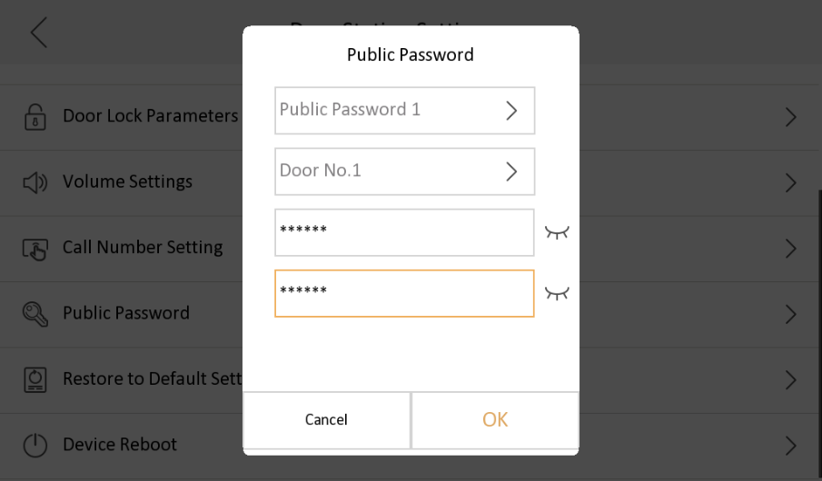
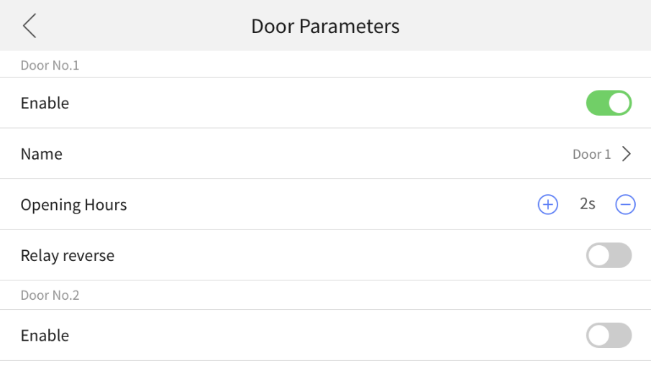
Easy UI 2.0
On-device configuration
Language setting
Sub-module Configuration
Intercom parameters
Equipment Information Search
Name setting
Lock Configuration
Pin Code Setting
Network parameters
Equipment maintenance
Volume Configuration
Public Password Function
Supports password to open the door
Door station lock configuration
Configuration of two locks and related parameters
Notes:
The new UI allows the indoor station to directly configure the door station, eliminating the need for a computer and expertise. However, note here that this is not part of the boot wizard. In addition to configuring the basic parameters of the door station, this upgrade allows the indoor station to configure two locks and related parameters, and to configure a public password to open the door, while the new card issuance mode allows the sub-card to open the door as well.
With this update, the new UI 2.0 can significantly solve the problems faced by installers and make the device more convenient to use.
新的用户界面允许室内机直接配置门口机，不需要电脑和专业知识。但这里注意一下，去PC化配置并不是启动向导的一部分。除了配置门口机的基本参数外，这次升级还允许室内机配置两个锁及有关的参数，并配置一个公共密码来开门，且母卡发卡模式也使子卡具备了开门功能。
通过这次的升级，新UI 2.0可以大大解决安装商所面临的问题，使设备的使用更加便捷。

Slide 13
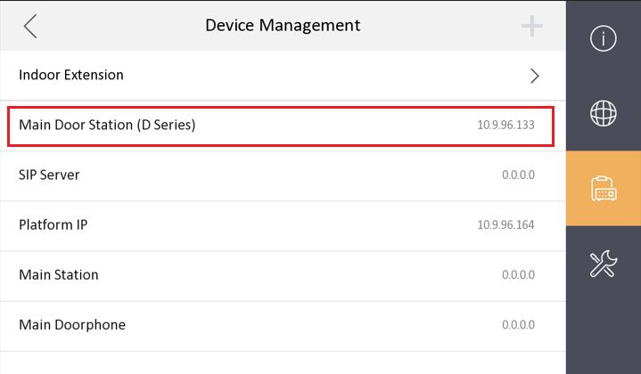
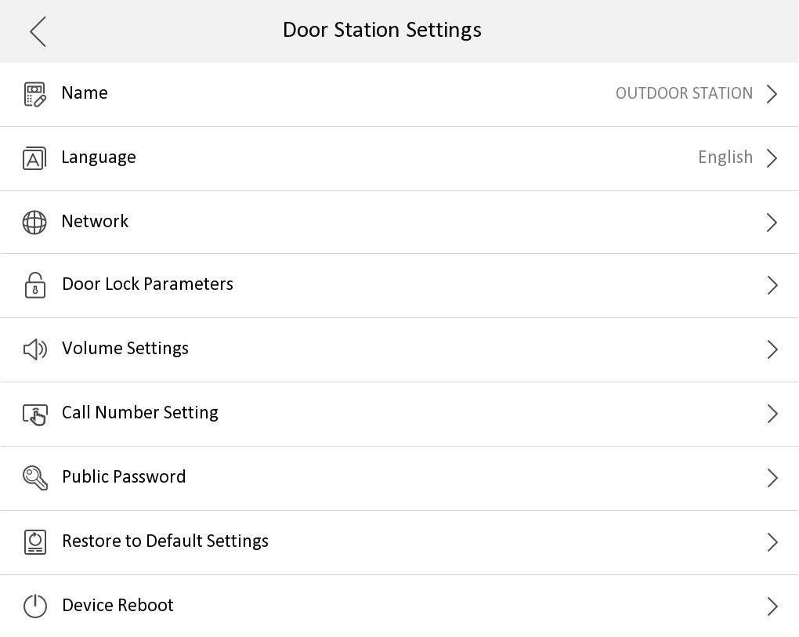
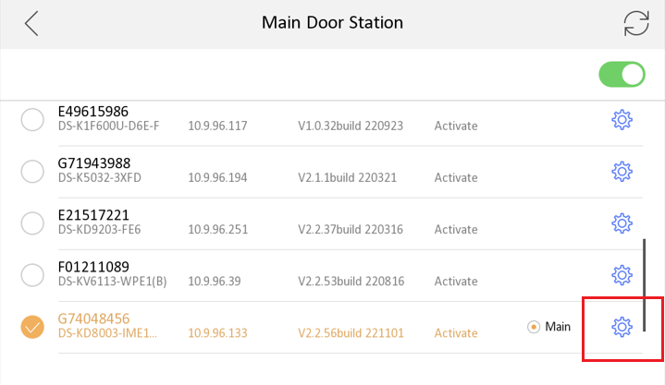
Easy UI 2.0
On-device configuration
Path: Menu-Advanced settings-Configuration-Device Management-Main Door Station
Notes:
Please use slideshow full screen

Slide 14
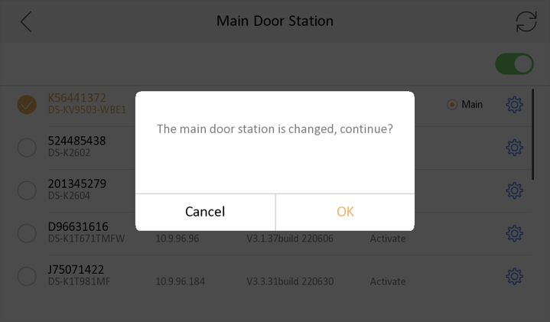
Easy UI 2.0
On-device configuration
1.You can change parameters of all door station (no matter it’s linked or not) in the list by click the setting icon
2.You can also change linked main door station from this list by click device from the list, if you want to change linked sub door station, please go to Advanced settings-Configuration-System maintenance-Wizard, and link device again.
3.After change the linked main door station, device will prompt “The main door station is changed, continue?”, see picture in the up-right
Notes:
Please use slideshow full screen

Slide 15
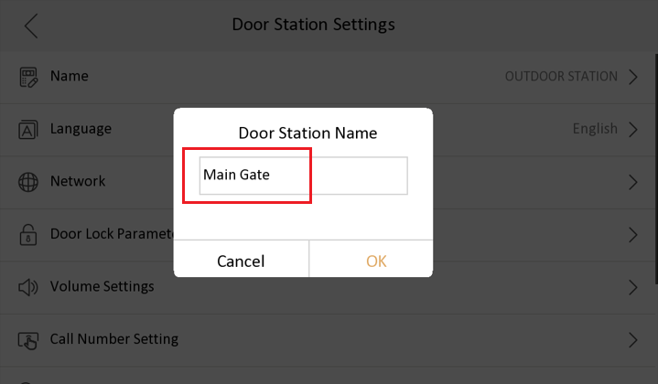
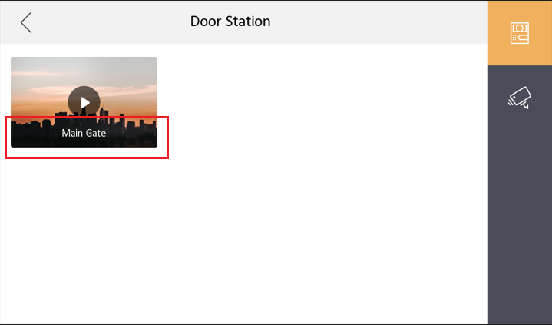
Easy UI 2.0
On-device configuration--Door station name
Set door station name (will be displayed in live view page), set door station language (Not support special character / \ : * ? ’ ” < > | %)
Notes:
Please use slideshow full screen

Slide 16
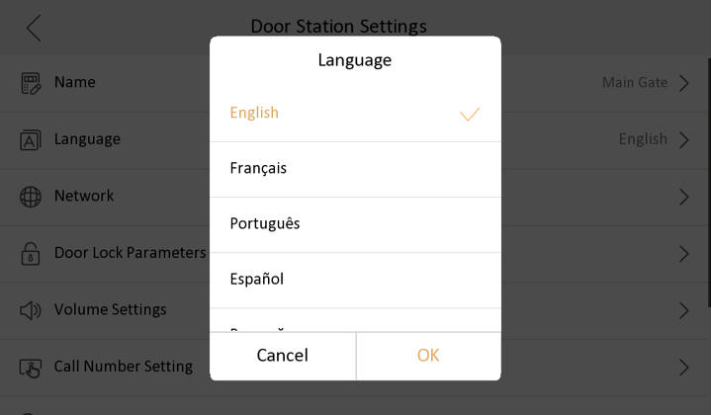
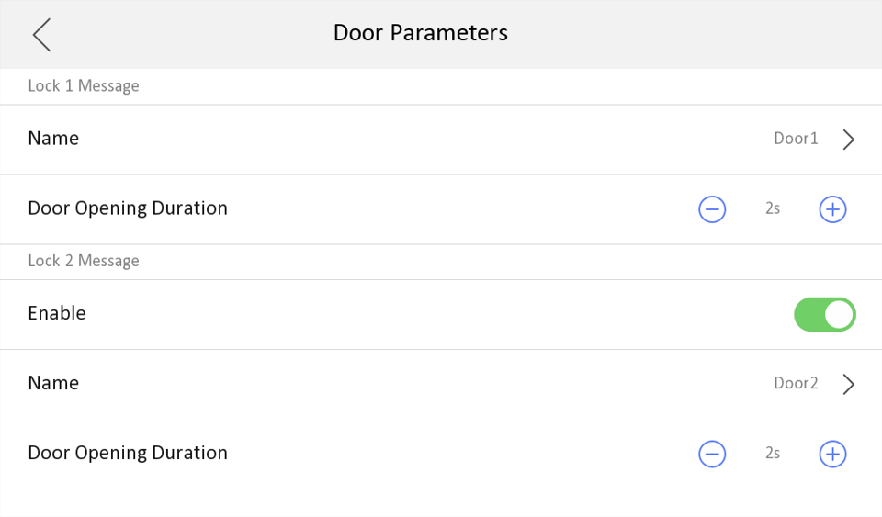
Easy UI 2.0
On-device configuration-- Language & Door parameter
Door parameters:
Set door name (will be displayed in iVMS event center)
After change language, door station will reboot to take effect
Notes:
Please use slideshow full screen

Slide 17
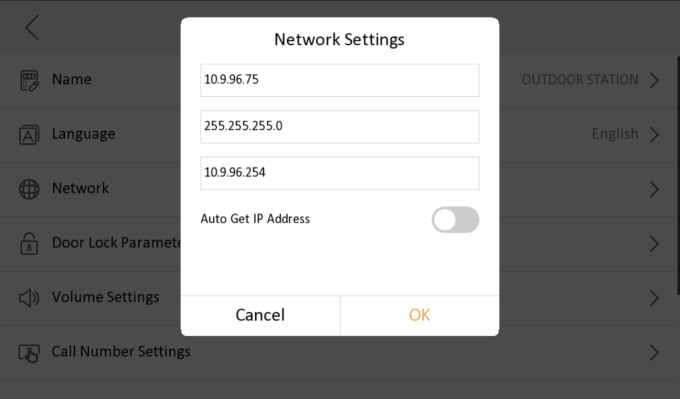
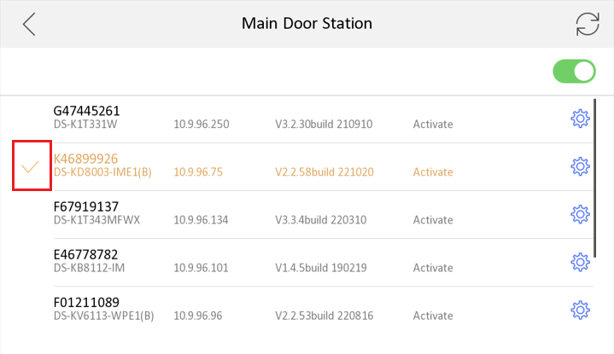
Easy UI 2.0
On-device configuration—Network setting
Set door station IP address, subnet mask, gateway, enable DHCP
Note：After door station network parameter change, return to the previous page, check whether network parameter changed or not, indoor station will disconnect from previous door station IP address, and please select the door station again, if you don’t find it, please refresh the device list from up right corner
Notes:
Please use slideshow full screen

Slide 18
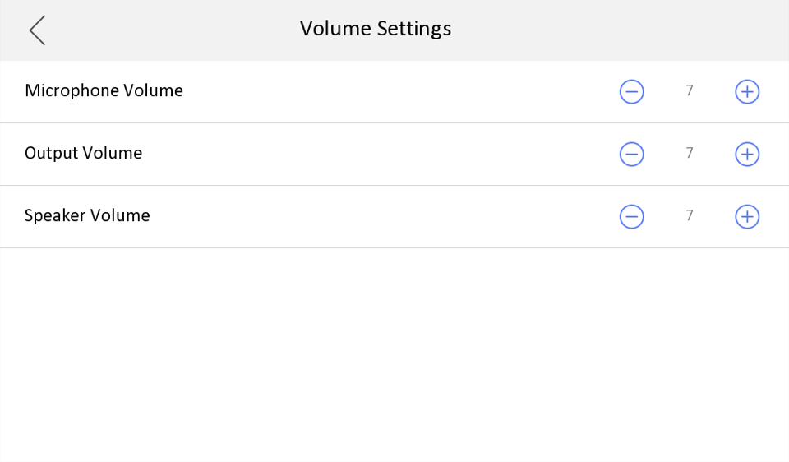
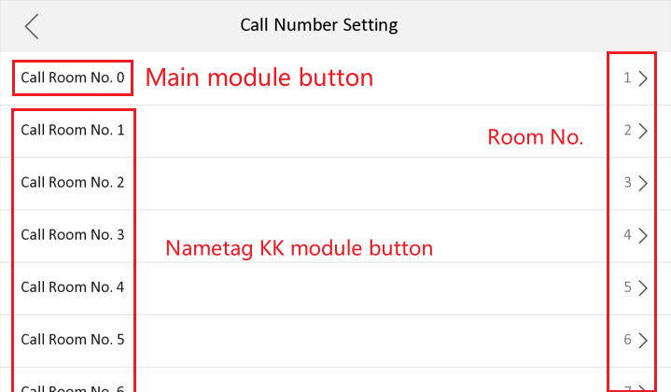
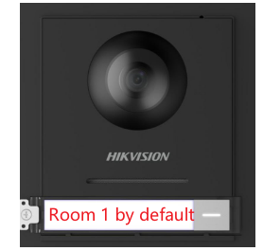
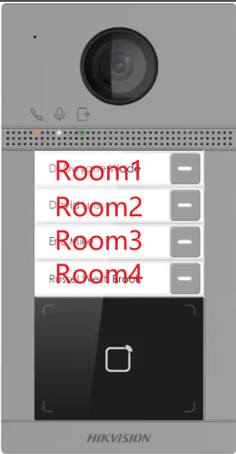
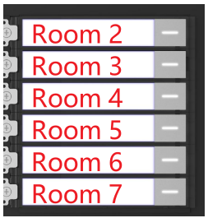
Easy UI 2.0
On-device configuration--Volume Settings & Public password
Set door station volume
Set KD8003 and KV8213/8413 physic button calling Room number
Notes:
Please use slideshow full screen

Slide 19
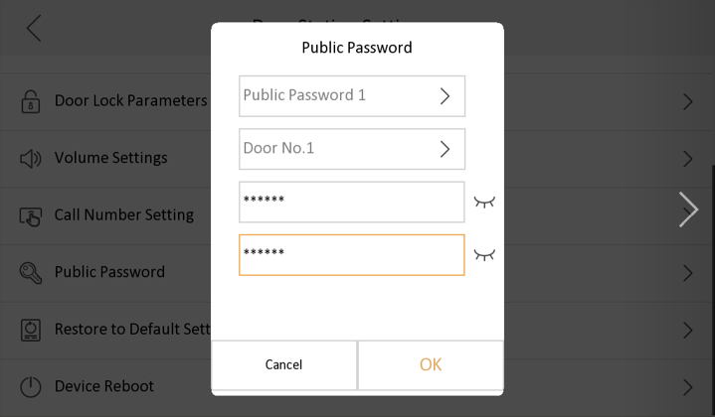
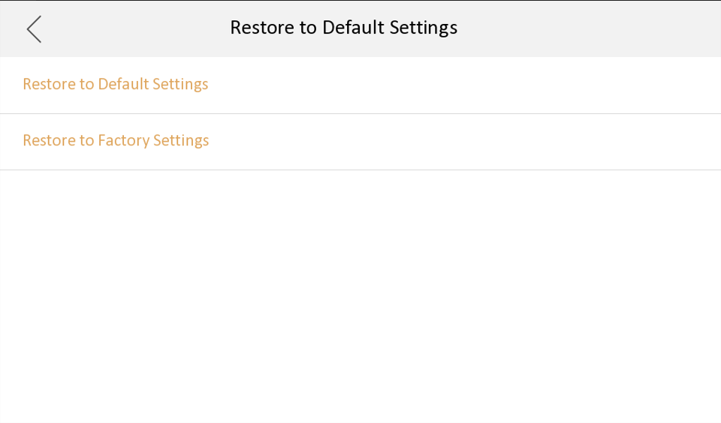
Easy UI 2.0
On-device configuration--Volume Settings & Restore
Set door station public password for door1 or door2, use different password to open different door on same keypad module
Note: maximum support 16 public passwords
Reboot or restore door station to default settings or factory settings
Note:
Default settings will keep activation password and network parameter
Notes:
Please use slideshow full screen

Slide 20
Easy Wizard
On-device configuration
FAQ
CONTENTS

Slide 21
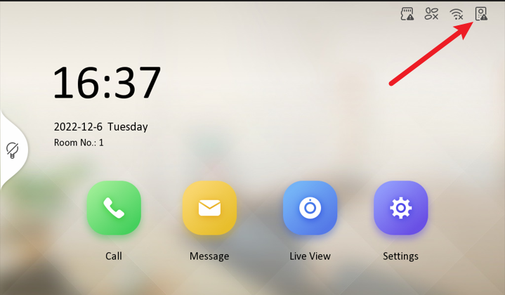
FAQ-Status
Q1. What’s the meaning of the icon in the up-right corner?
A1. Please refer to the table on the right, if the indoor station register to
door station failed, we can’t call from door station and it prompt “calling failed”
Please link door station in wizard again:
Settings-Advanced settings-Configuration-System Maintenance

Slide 22
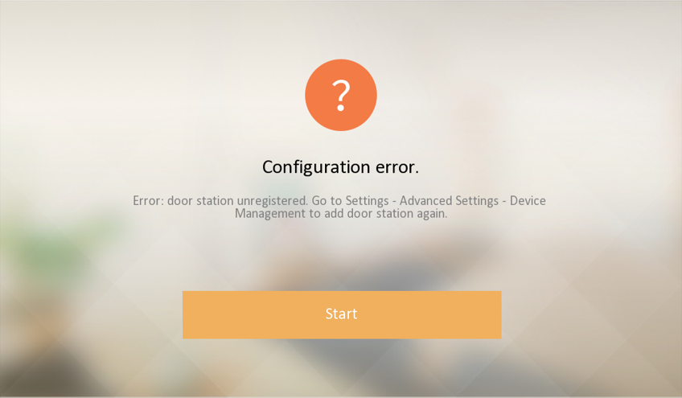
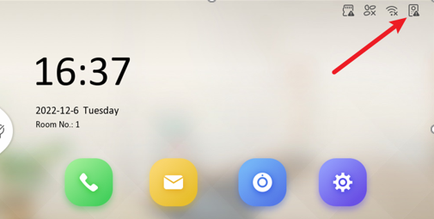
FAQ-Configuration error
Q2. It prompt configuration error after the wizard finish, why and what should I do?
A2. Possible reason for configuration error:
The door station is offline (network unreachable), make sure the door station is power on and in the same network with indoor station.
When the door station has a different activation password from indoor station, it will prompt to input correct activation password, if you don’t input, it will result to configuration error.
Add sub door station to door station failed, please check main and sub door station network connection and make sure they have same activation and registration password.
The door station has already added another indoor station which has same room number or IP, delete it first from door station remote configuration menu--device management list, then click the door station icon in the up right corner to register again, see pic2
Notes:
配对失败，几种错误提示及解决方法，最后提供打印日志提交问题单
解决方法有两种：
1.室内机本地--重新进入室内机向导， 勾选并关联新的门口机，会提示输入门口机的密码
2.从iVMS4200--在门口机里面添加室内机，等待下一个注册周期或在室内机右上角点击门口机图标，触发立即注册

Slide 23
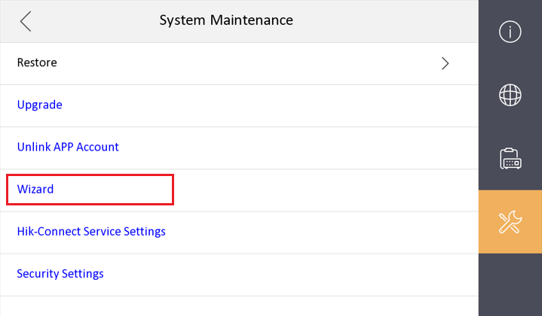
FAQ-Calling failed
Q3. It prompt calling failed when I press button on door station, why and what should I do?
A2.
Please check the registration status in the indoor station up-right corner first, if it shows
1.click the icon to register to door station manually, if register failed, it will indicate the reason for the failure and follow the prompt to solve it.
2.Go to the indoor station Settings-Menu-Advanced settings-System Maintenance-Wizard, and link door station again.
If it shows in the up-right corner, please refer to next page
Notes:
呼叫失败，几种错误提示及解决方法，如果无法解决，最后提供打印日志TMOUT=0, outputOpen, errputOpen，并提交问题单
解决方法有两种：
1.室内机本地--重新进入室内机向导， 勾选并关联新的门口机，会提示输入门口机的密码
2.从iVMS4200--在门口机里面添加室内机，等待下一个注册周期或在室内机右上角点击门口机图标，触发立即注册
注册周期：
1.室内机上电后会随机个1-15秒后发起注册。
2.刷新注册周期是序列号最后2位*6+600秒，当来电的时候，如果室内机比门口机先启动起来，室内机发起注册的时候，门口机没有启动完成，没有给响应，就会等下一个注册周期才会发起注册

Slide 24
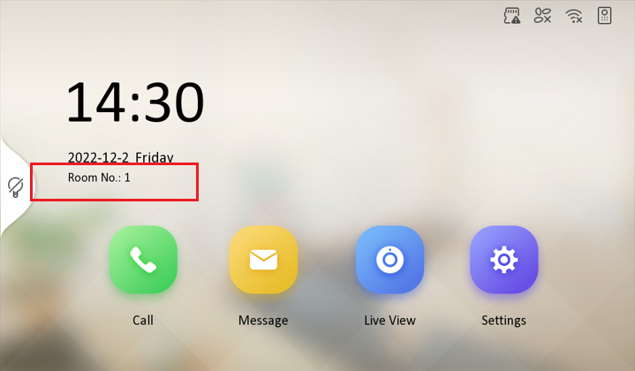
FAQ-Calling failed
Q3. The indoor station icon also shows , means indoor station registered to door station success, but calling failed from door station.
A3. Please check the indoor station screen room number is 1 or not, because KD8003 door station button call room 1 by default. If not, you can modify the door station call number from indoor station menu advanced Setting—Device management-Main door station-Door station settings-Call Number Setting
Notes:
门口机主模块的按钮默认是呼叫房间号1，如果室内机不是房间号1，会呼不通，可以通过室内机本地UI修改门口机呼叫的房间号号码，与室内机实际房间号保持一致即可

Slide 25
FAQ-Indoor extension compatibility
Q4. Can I link protocol 1.0 indoor station as indoor extension (earlier than V2.1.10) ?
A4. Yes, enable from Advanced setting-Local information-SIP settings, after enable it’s compatible with protocol 1.0 indoor extension and not compatible with protocol 2.0 indoor extension.
Note: After enable, all indoor extension of this indoor station must be protocol 1.0 firmware, don’t mix protocol 1.0 and 2.0 indoor extension under same indoor station, or it will result to calling failed.

Slide 26
Thanks
International Product and Solution Center

